Slide 1
Extreme diversity and cryptic species in the toxic bloom-forming alga Prymnesium parvum
Jen Wisecaver - jwisecav@purdue.edu
(Sobieraj and Metelski 2023 Toxins)
Notes:
I would also like to acknowledge all of my collaborators as well as our NSF Dimensions of Biodiversity funding, both of which have been instrumental in making this project possible. This video that's been playing in the background shows Prymnesium parvum feeding by phagocytosis on what used to be a green alga here in the center of the screen. It was variation in this phagocytic behavior that first really piqued my interest in prymnesium.

Slide 2
P. parvum is a photosynthetic predator
“People had postulated that a haptonema might be involved in feeding, but many of us discounted this idea because haptophytes are generally photosynthetic. Little did we suspect what dark deeds could be done by such little plants.”
- Ralph A. Lewin 1992 Nature
Notes:
I would also like to acknowledge all of my collaborators as well as our NSF Dimensions of Biodiversity funding, both of which have been instrumental in making this project possible. This video that's been playing in the background shows Prymnesium parvum feeding by phagocytosis on what used to be a green alga here in the center of the screen. It was variation in this phagocytic behavior that first really piqued my interest in prymnesium.

Slide 3
Variation in feeding behavior in P. parvum
Questions
What genetic differences underly this feeding variation?
How do these differences impact other aspects of P. parvum biology including the species ability to form toxic blooms?
Golden algae
Cell density grown with prey versus without prey
Driscoll et al. 2023 Ecology Letters
Notes:
My lab is working to understand the genetic differences that underly this phenotypic variation and how these differences impact other aspects of prymnesium biology including it's ability to form toxic blooms.

Slide 4
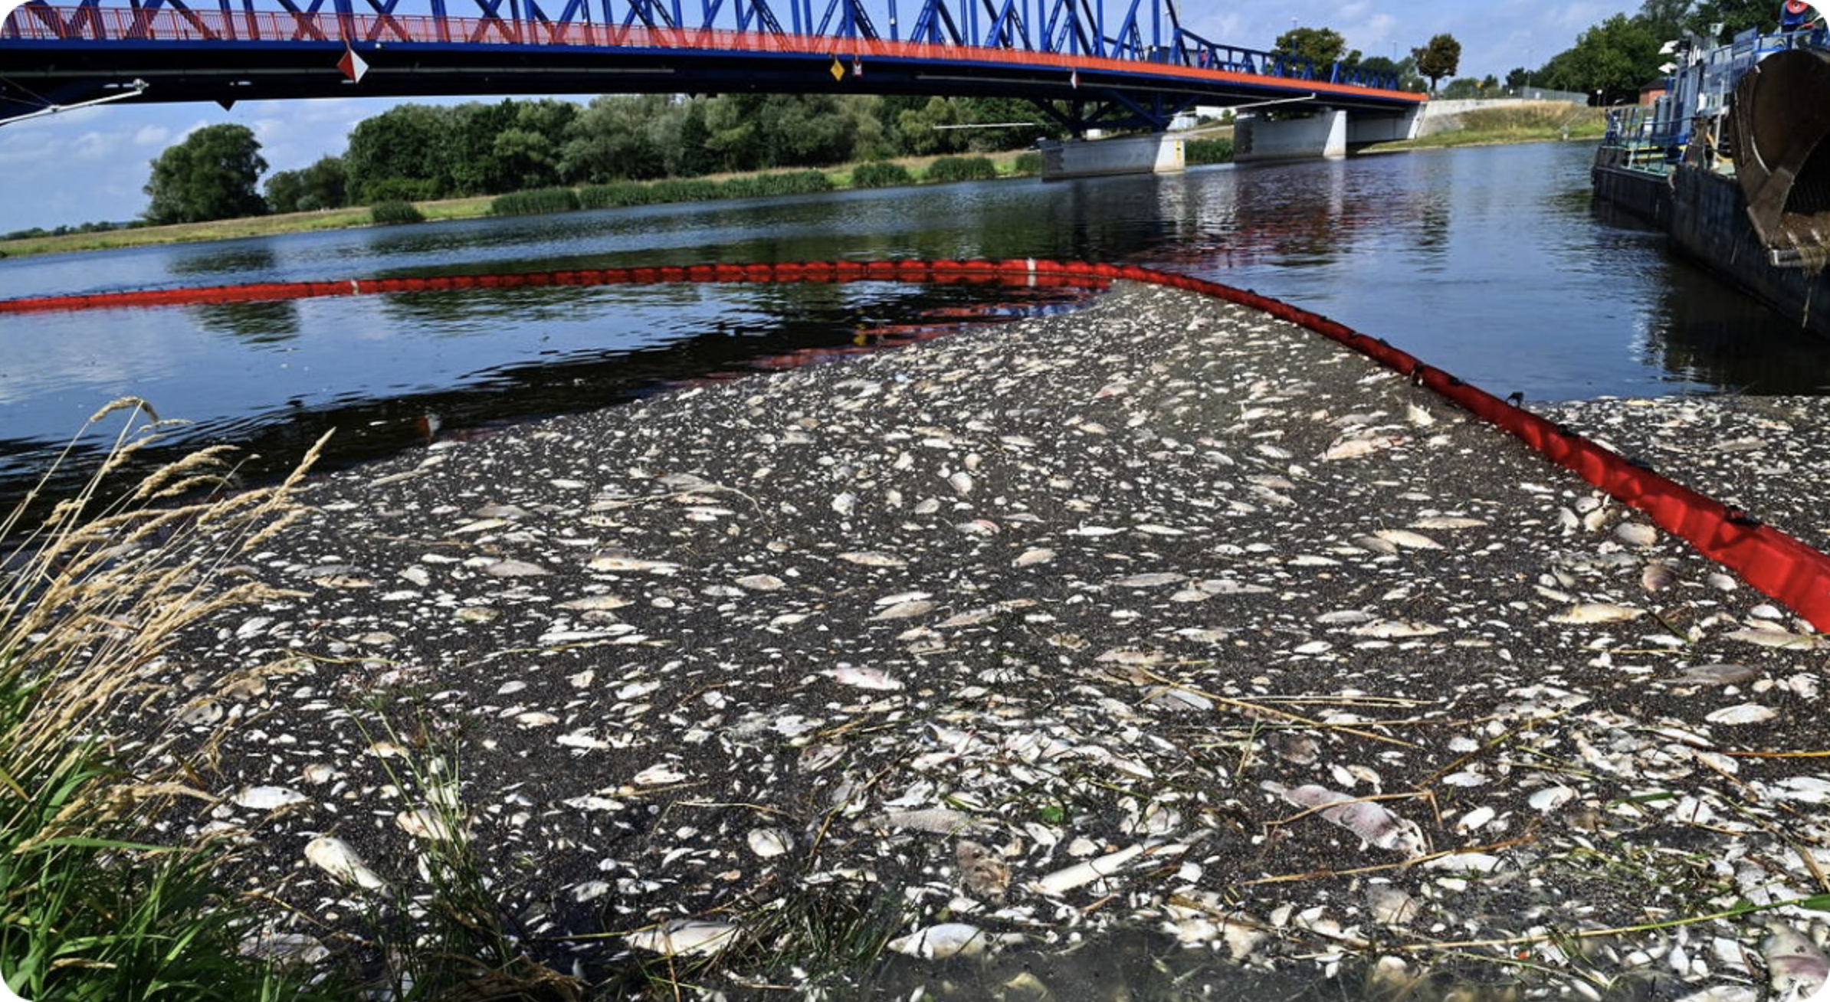
2022 Odra River Catastrophe (Germany & Poland)
Massive P. parvum bloom in the Odra River from July to August 2022
525 miles of impacted waterways,
249 tons of dead fish
P. parvum bloom "was only a matter of time" Odra river is permanently saline due to drought and runoff from agriculture and mining (Sobieraj and Metelski 2023)
"Prymnesium parvum has the potential for high environmental and socioeconomic impacts if introduced to the Great Lakes"
Notes:
And there is still a lot about Prymnesium parvum that we do not know. For one thing the lifecycle of the species is still uncharacterized, we don't know how frequently is undergoes sexual reproduction or under what conditions. How much genetic diversity is present in the species worldwide, in the US, and in Texas specifically where Prymnesium blooms most common?

Slide 5
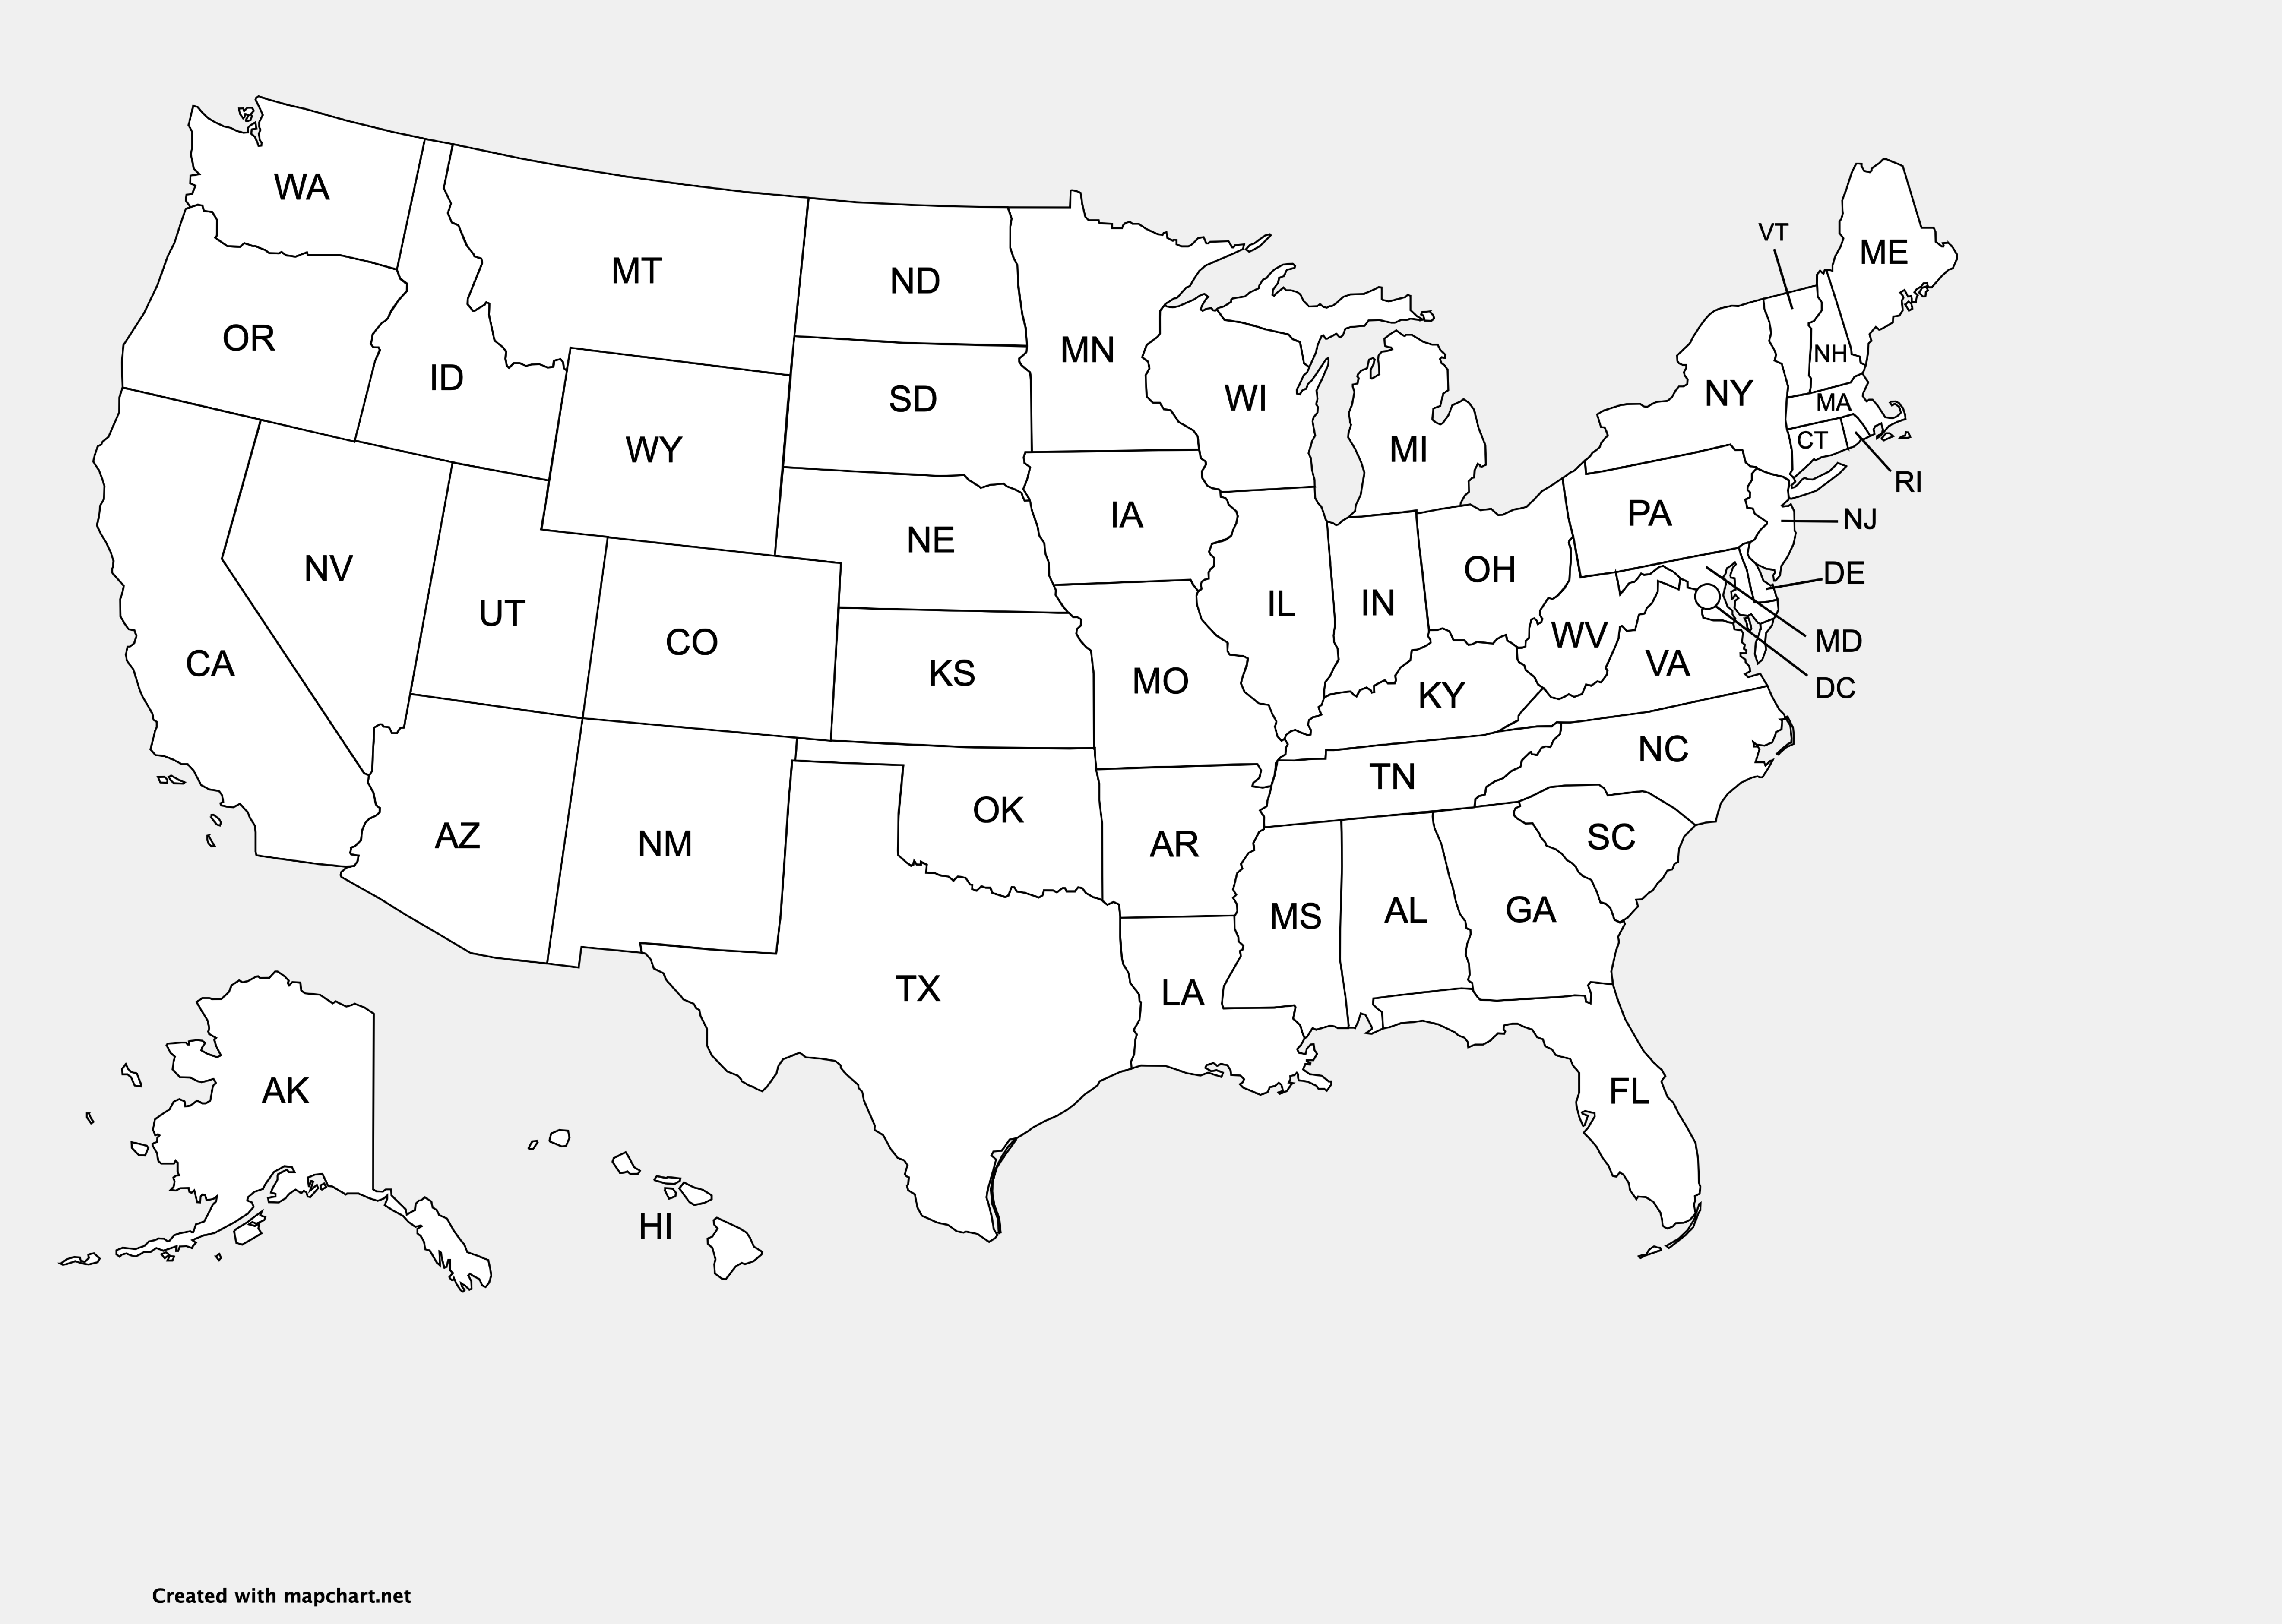
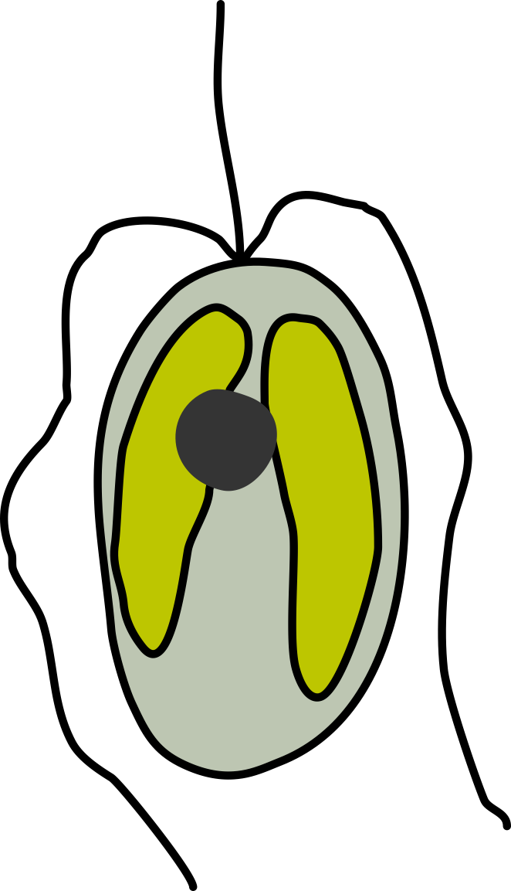
P. parvum distribution in the USA
1985
created with mapchart.net
Notes:
Prymnesium parvum can be found all over the world, but the first confirmed case of a prymnesium parvum bloom in the US was in Texas in 1985.

Slide 6
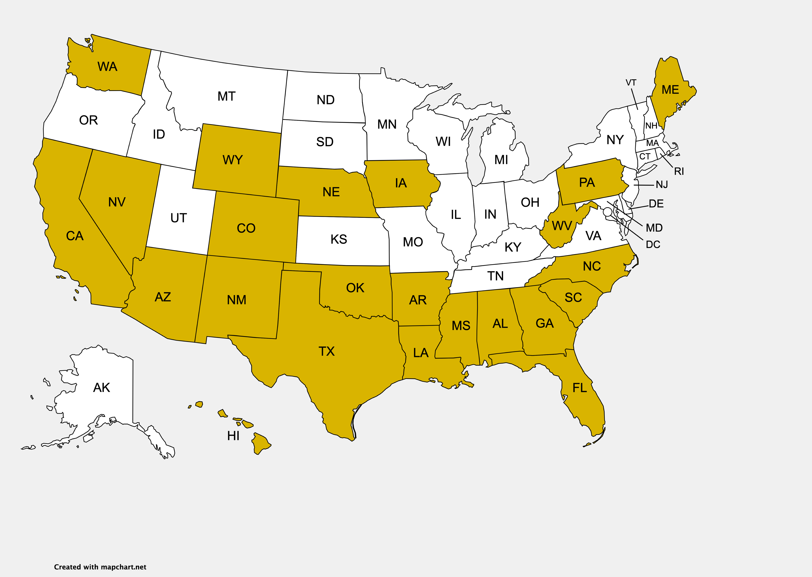
P. parvum distribution in the USA
2016
Prymnesium detected in 23 states
(Roelke et al 2016)
created with mapchart.net
Notes:
Fast forward 31 years to 2016 and prymnesium parvum has been detected in 23 states

Slide 7
P. parvum distribution in the USA
2016
Factors associated with increased Prymnesium blooms
(Tábora-Sarmiento et al. 2022 )
higher salinity
decreased wetland cover
increased use of Glyphosate herbicides
Prymnesium detected in 23 states
(Roelke et al 2016)
created with mapchart.net
Notes:
Several abiotic factors appear to be associated with increased Prymnesium blooms in the southern US including increased salinity, decreased wetland cover, increased use of glyphosate herbicides, and increased concentrations of air CO2. These factors suggest that Prymnesium blooms in the US are here to stay and will likely increase in severity and continue to spread into neighboring states.

Slide 8
P. parvum distribution in the USA
2016
Factors associated with increased Prymnesium blooms
(Tábora-Sarmiento et al. 2022 )
higher salinity
decreased wetland cover
increased use of Glyphosate herbicides
Prymnesium X Factors
life cycle and genetic diversity
Prymnesium detected in 23 states
(Roelke et al 2016)
created with mapchart.net
Notes:
And there is still a lot about Prymnesium parvum that we do not know. For one thing the lifecycle of the species is still uncharacterized, we don't know how frequently is undergoes sexual reproduction or under what conditions. How much genetic diversity is present in the species worldwide, in the US, and in Texas specifically where Prymnesium blooms most common?

Slide 9
P. parvum chemotypes and evolution
A-type prymnesins
(prymnesin-2)
91 carbon backbone
B-type prymnesins
(prymnesin-B1)
85 carbon backbone
???
C-type prymnesins
83 carbon backbone
Igarashi et al. 1996, 1999
Rasmussen et al. 2016
Notes:
Prymnesium parvum likely produces a suite of toxic compounds, the most well known of which prymnesin. Prymnesins are extremely large and complex metabolites that are hemolytic and toxic to fish and other aquatic organisms. Several different types of prymnesins have been identified and are differentiated by length of their carbon backbone. A-type prymnesins have 91 carbons, B-type have 85, and C-types have 83. Both A- and B-type prymnesins have been structurally characterized, while the exact structure of C-type prymnesins is unknown.

Slide 10
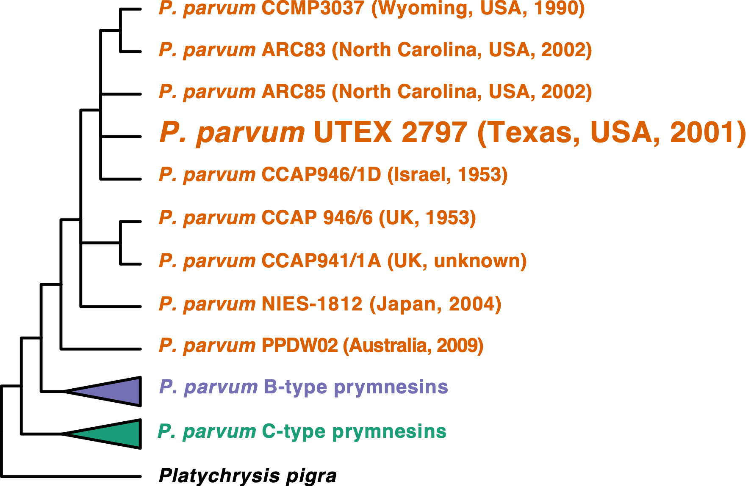
P. parvum chemotypes and evolution
A-type prymnesin
producers
Binzer et al. 2019
ribosomal DNA phylogeny
Notes:
Recent evolutionary analyses suggest that these different prymnesin types are phylogenetically distinct. This ITS based phylogeny is modified from Binzer at al. and you see that A-, B-, and C- type producing P parvum strains each form a monophyletic clade. I've collapsed the B- and C- type clades to focus on the A-type producers, because the majority of characterized strains in the US produce A-type prymnesins, including the only characterized strain from Texas UTEX 2797.

Slide 11
Selecting a Prymnesium parvum reference strain
for whole genome sequencing
UTEX 2797
Commonly used Texas strain
isolated in 2001
Produces A-type prymnesin
DNA content 274 Mbp
Notes:
While screening additional Texas strains, we came across 12B1, which was first isolated from a bloom in 2010. The attractive thing about 12B1 from a genome sequencing point of view is that its total DNA content is half that of UTEX 2797 and correspondingly it has no observable heterozygosity, which suggested that 12B1 could be a haploid isolate.
However, not wanting to abandon UTEX2797 since it is such a commonly used strain, we decided to sequence the genomes of both UTEX 2797 and 12B1 using a combination of Illumina, oxford nanopore, and Hi-C sequencing technology.

Slide 12
Selecting a Prymnesium parvum reference strain
for whole genome sequencing
UTEX 2797
Commonly used Texas strain
isolated in 2001
Produces A-type prymnesin
DNA content 274 Mbp
Notes:
While screening additional Texas strains, we came across 12B1, which was first isolated from a bloom in 2010. The attractive thing about 12B1 from a genome sequencing point of view is that its total DNA content is half that of UTEX 2797 and correspondingly it has no observable heterozygosity, which suggested that 12B1 could be a haploid isolate.
However, not wanting to abandon UTEX2797 since it is such a commonly used strain, we decided to sequence the genomes of both UTEX 2797 and 12B1 using a combination of Illumina, oxford nanopore, and Hi-C sequencing technology.

Slide 13
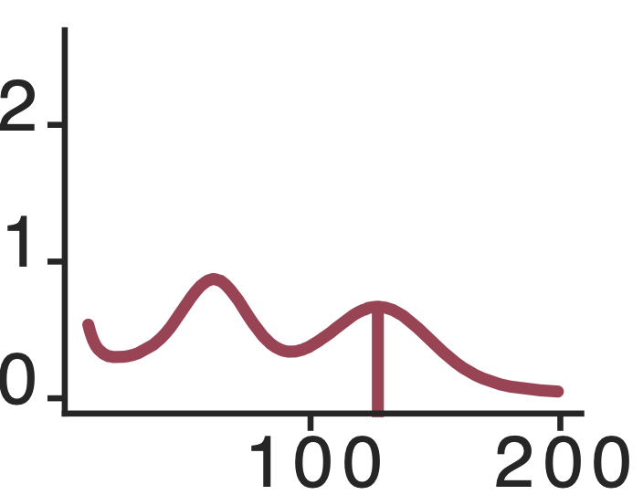
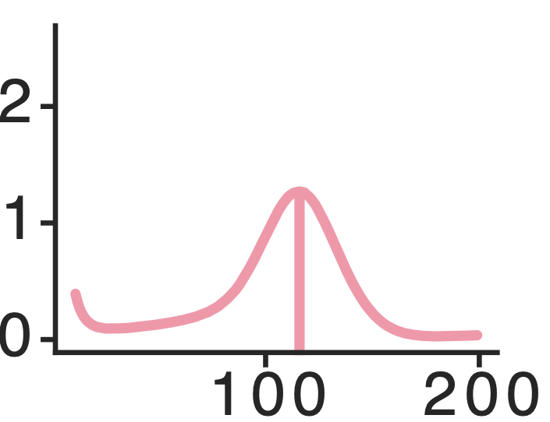
Selecting a Prymnesium parvum reference strain
for whole genome sequencing
UTEX 2797
Commonly used Texas strain
isolated in 2001
Produces A-type prymnesin
DNA content 274 Mbp
BUT high heterozygosity
12B1
Strain isolated from Texas bloom in 2010
(Driscoll et al. 2013)
DNA content 116 Mbp
No observable heterozygosity
Unique Kmers
(1 x 10⁶)
Unique Kmers
(1 x 10⁶)
Kmer Coverage
Kmer Coverage
Notes:
While screening additional Texas strains, we came across 12B1, which was first isolated from a bloom in 2010. The attractive thing about 12B1 from a genome sequencing point of view is that its total DNA content is half that of UTEX 2797 and correspondingly it has no observable heterozygosity, which suggested that 12B1 could be a haploid isolate.
However, not wanting to abandon UTEX2797 since it is such a commonly used strain, we decided to sequence the genomes of both UTEX 2797 and 12B1 using a combination of Illumina, oxford nanopore, and Hi-C sequencing technology.

Slide 14
Selecting a Prymnesium parvum reference strain
for whole genome sequencing
UTEX 2797
Commonly used Texas strain
isolated in 2001
Produces A-type prymnesin
DNA content 274 Mbp
BUT high heterozygosity
12B1
Strain isolated from Texas bloom in 2010
(Driscoll et al. 2013)
DNA content 116 Mbp
No observable heterozygosity
Unique Kmers
(1 x 10⁶)
Unique Kmers
(1 x 10⁶)
...we decided to sequence both UTEX 2797 and 12B1 using a combination of Illumina, Oxford Nanopore, and Hi-C sequencing technology
Kmer Coverage
Kmer Coverage
Notes:
While screening additional Texas strains, we came across 12B1, which was first isolated from a bloom in 2010. The attractive thing about 12B1 from a genome sequencing point of view is that its total DNA content is half that of UTEX 2797 and correspondingly it has no observable heterozygosity, which suggested that 12B1 could be a haploid isolate.
However, not wanting to abandon UTEX2797 since it is such a commonly used strain, we decided to sequence the genomes of both UTEX 2797 and 12B1 using a combination of Illumina, oxford nanopore, and Hi-C sequencing technology.

Slide 15
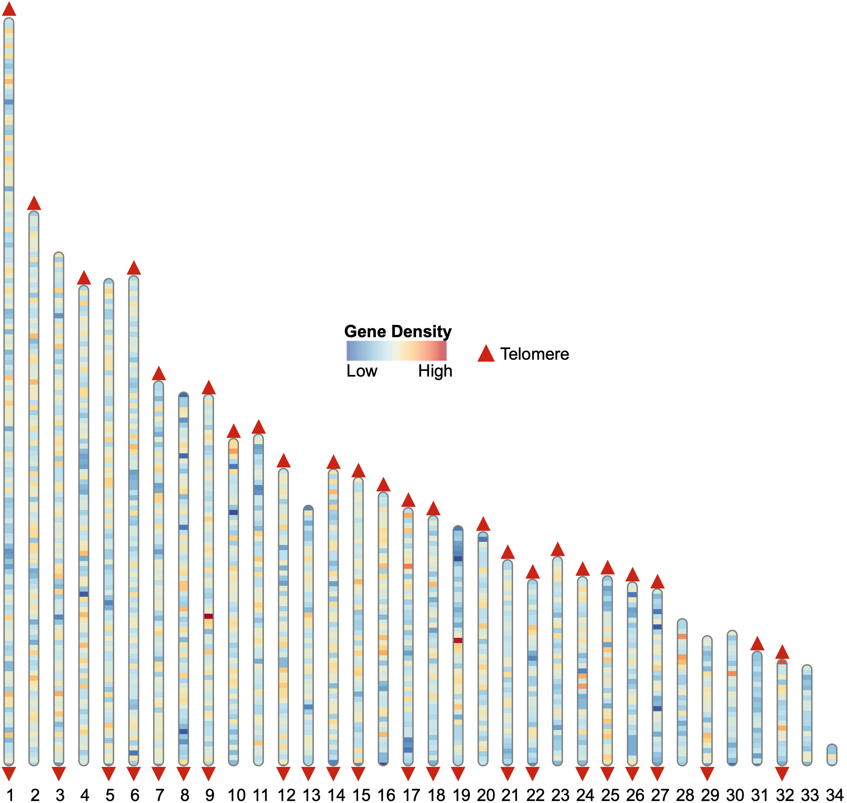
P. parvum genome assemblies are highly contiguous
12B1
94 Mbp on 34 scaffolds
Telomeric repeats on one or both ends of may scaffolds
23,820 protein coding genes
UTEX 2797
198 Mbp on 66 scaffolds
45,535 protein coding genes
12B1 Assembly Scaffolds
Notes:
UTEX 2797's assembly was over twice as long at 198 million basepairs on 66 scaffolds. It also had nearly twice as many protein coding genes compared to 12B1. UTEX 2797's assembly being twice was really exciting to us, because it again illustrated the strain's high level of heterozygosity and just how different the homologous chromosome pairs of UTEX2797 were to each other, that they could be assembles into distinct scaffolds and not collapsed into one. It suggested something interesting may be going on in the evolutionary history of UTEX2797. But we needed genome level data from additional strains to investigate further.

Slide 16
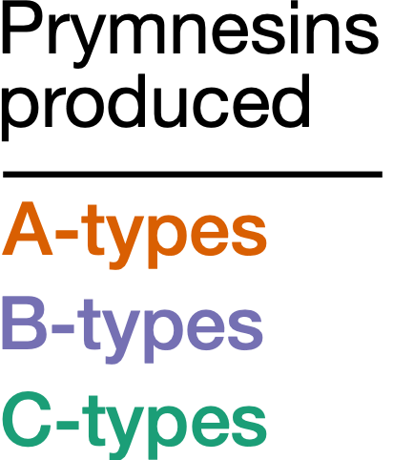
P. parvum strain diversity
Maximum likelihood phylogeny of 2699 single-copy genes
A-, B-, and C-type P. parvum form three separate groups
Notes:
So we decided to survey an additional 13 strains of Prymnesium parvum that we selected based on the type of prymnesin they produced. We selected 4 additional A-type producers, 4 that made B-type prymnesin, 5 that made C-type prymnesin, We assembled the genomes of all 13 strains using illumina reads only, so their assemblies are far more fragmented than our first two, but they are sufficient for recovering the coding regions for phylogenetic analyses.
We created a concatenated, maximum likelihood species tree using 2,699 single copy genes. And like the earlier ITS based phylogeny of Prymnesium parvum, our tree supports the monophyletic origin of A-, B-, and C-type prymnesins

Slide 17
P. parvum strain diversity
Increased substitution rate between A-, B-, and C-type clades.
Increased substitution rate within C-types.
Long branch of UTEX 2797 due to inconsistent location between gene trees
Notes:
The coding regions themselves were also significantly divergent between subclades of prymnesium parvum. Average nucleotide sequence identity between C-type strains and A- and B- type strains is less than 96%, and this is in conserved single copy protein coding regions.

Slide 18
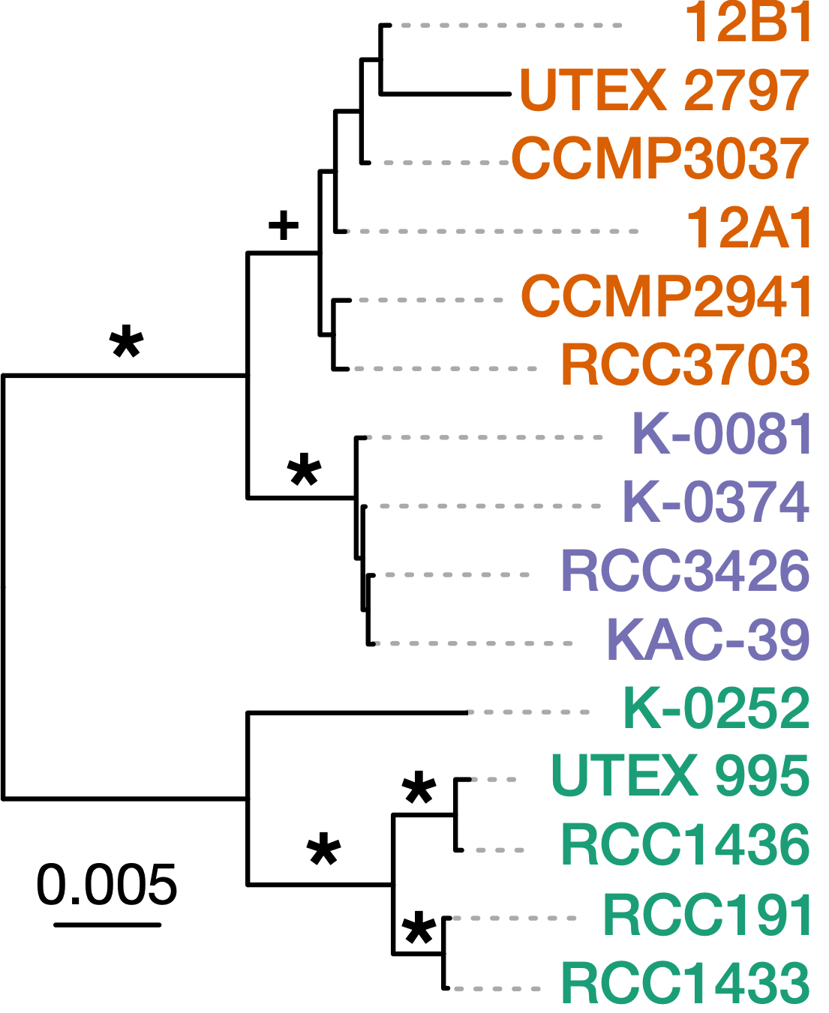
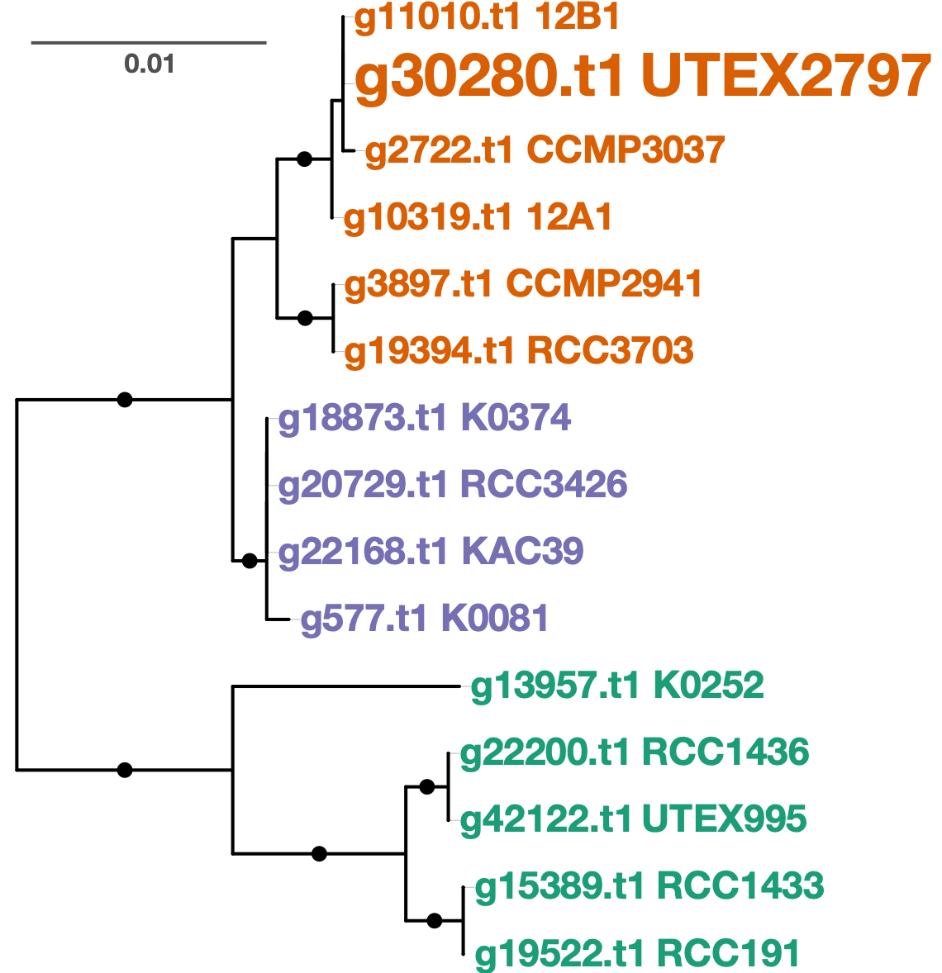
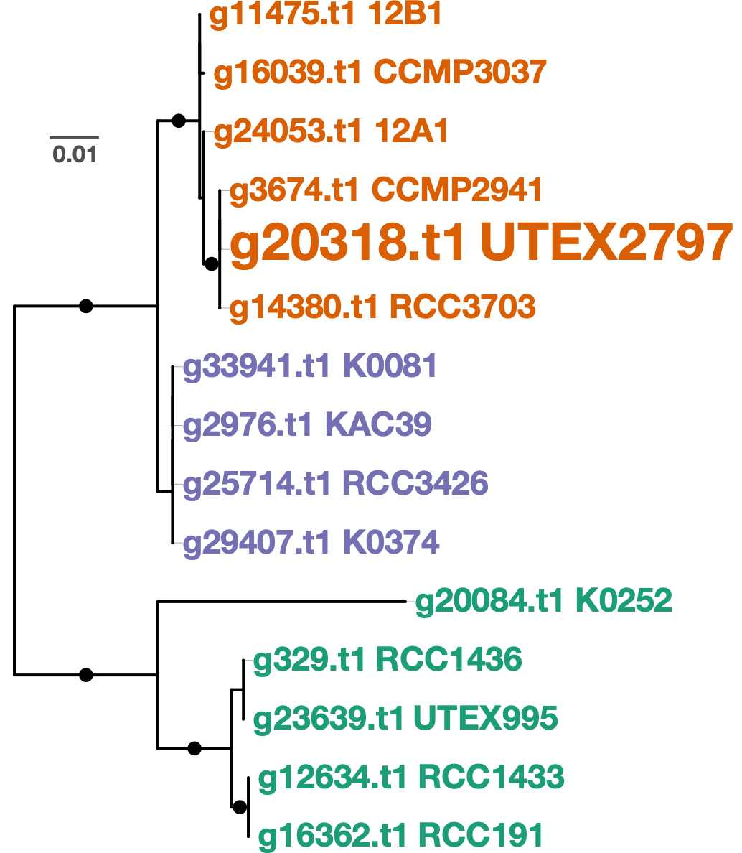
P. parvum strain diversity
Gene Tree 1
Gene Tree 2
UTEX 2797 groups with
12B1 (Texas) and
CCMP3037 (Wyoming)
UTEX 2797 groups with
RCC3707 (England) and
CCMP2941 (Russia)
Notes:
However in this second tree, you see the placement of UTEX2797 is completely different. It is grouping instead with RCC3707 and CCMP2941 from England and Russia.

Slide 19
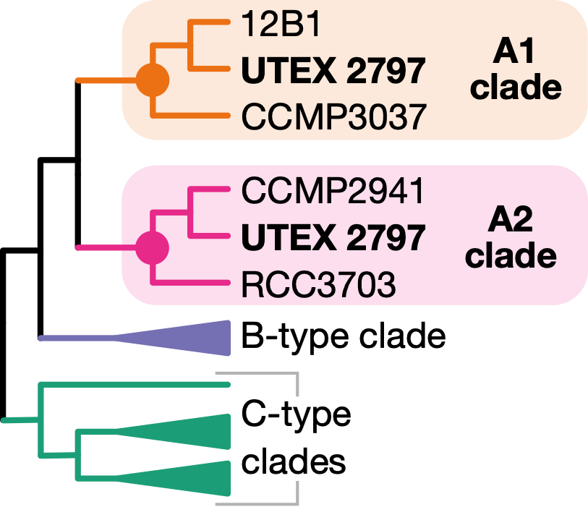
P. parvum strain diversity
UTEX 2797 is a hybrid with two phylogenetically distinct A-type subgenomes
Across UTEX 2797 genome:
31 scaffolds grouped with A1 clade
31 scaffolds grouped with A2 clade
4 scaffolds unclear
Notes:
However in this second tree, you see the placement of UTEX2797 is completely different. It is grouping instead with RCC3707 and CCMP2941 from England and Russia.

Slide 20
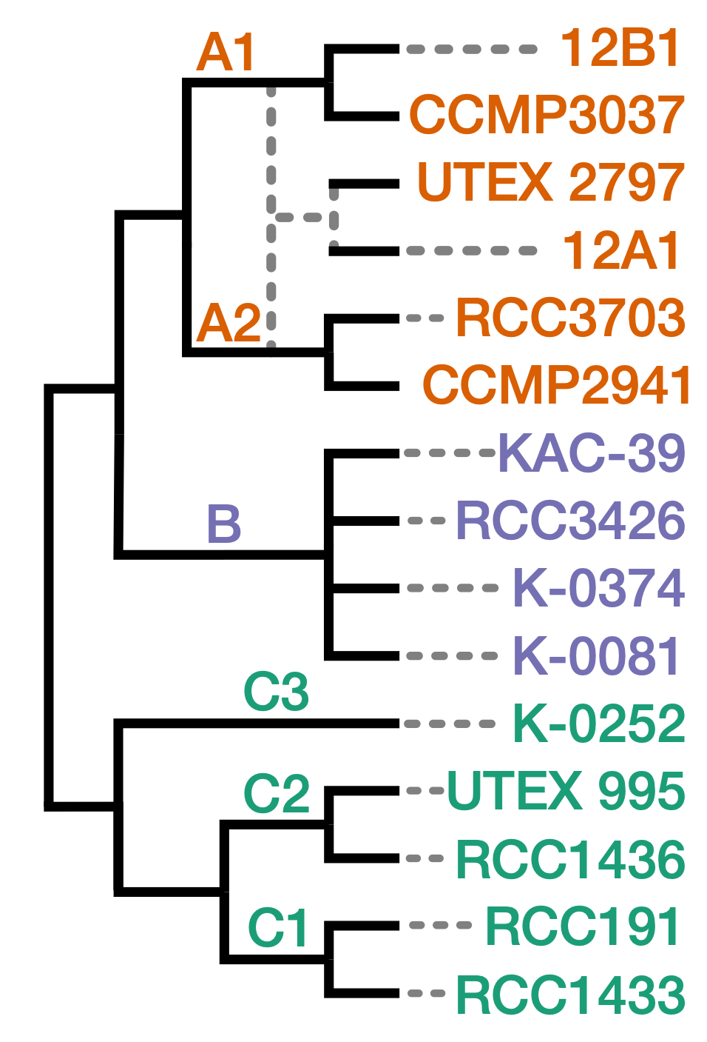
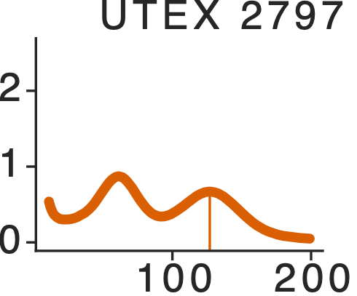
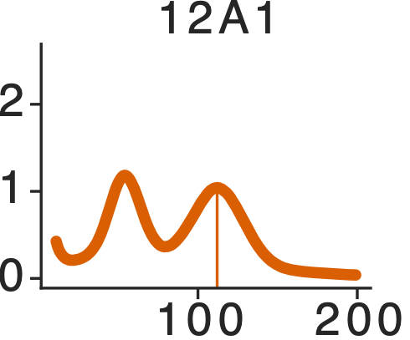
Genome diversity in P. parvum
Multiple hybrid strains
Notes:
We identified multiple strains that appear to be haploids, like 12B1, based on their single peak in kmer frequency plots. Here are three strains as an example, one for each chemotype. But you'll notice that the peak location changes for each strain, with the peak for the C-type strain RCC1433 being slightly to the left of 12B1s, and the B-type strain K-0374 being significantly to the left.

Slide 21
Genome diversity in P. parvum
Genome size (Mbp) | Genome count
116 | 1
118 | 2
 | 2
 | 2
140 | 2
121 | 4
359 | 1
268 | 1
285 | 1
211 | 4
204 | 2
215 | 2
235 | 2
151 | 1
154 | 1
Multiple hybrid strains
B-type genomes are > 2x larger than A-type genomes
Notes:
So just to recap all the genome variation present in just these 15 strains of Prymnesium parvum. We identified significant variation in haploid genome size between the different prymnesin chemotypes. We also found a lot of variation in ploidy or genome copy number between the different strains. In this talk I mostly focused on the haploids and UTEX 2797, but other strains in this analysis look to be diploid like or even triploid. And lastly, UTEX 2797 is a hybrid.

Slide 22
Genome diversity in P. parvum
Genome size (Mbp) | Genome count
116 | 1
118 | 2
137 | 2
145 | 2
140 | 2
121 | 4
359 | 1
268 | 1
285 | 1
211 | 4
204 | 2
215 | 2
235 | 2
151 | 1
154 | 1
Multiple hybrid strains
B-type genomes are > 2x larger than A-type genomes
strains can be haploid, diploid, even tetraploid
Notes:
So just to recap all the genome variation present in just these 15 strains of Prymnesium parvum. We identified significant variation in haploid genome size between the different prymnesin chemotypes. We also found a lot of variation in ploidy or genome copy number between the different strains. In this talk I mostly focused on the haploids and UTEX 2797, but other strains in this analysis look to be diploid like or even triploid. And lastly, UTEX 2797 is a hybrid.

Slide 23
Genome diversity in P. parvum
Genome size (Mbp) | Genome count
116 | 1
118 | 2
137 | 2
145 | 2
140 | 2
121 | 4
359 | 1
268 | 1
285 | 1
211 | 4
204 | 2
215 | 2
235 | 2
151 | 1
154 | 1
Multiple hybrid strains
B-type genomes are > 2x larger than A-type genomes
strains can be haploid, diploid, even tetraploid
Considerable genetic variation suggestive of 3-7 different cryptic species
Notes:
So just to recap all the genome variation present in just these 15 strains of Prymnesium parvum. We identified significant variation in haploid genome size between the different prymnesin chemotypes. We also found a lot of variation in ploidy or genome copy number between the different strains. In this talk I mostly focused on the haploids and UTEX 2797, but other strains in this analysis look to be diploid like or even triploid. And lastly, UTEX 2797 is a hybrid.

Slide 24
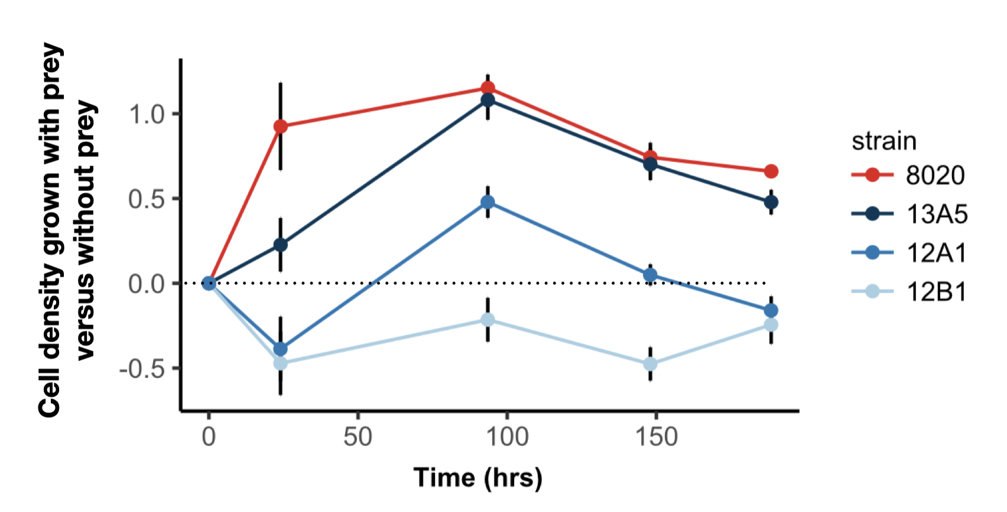
Genome diversity in P. parvum
What are the ecological consequences of this genetic variation?
8020 (A-type hybrid)
13A5 (A-type hybrid)
12A1 (A-type hybrid)
12B1 (A1-type)
Notes:
We identified multiple strains that appear to be haploids, like 12B1, based on their single peak in kmer frequency plots. Here are three strains as an example, one for each chemotype. But you'll notice that the peak location changes for each strain, with the peak for the C-type strain RCC1433 being slightly to the left of 12B1s, and the B-type strain K-0374 being significantly to the left.

Slide 25
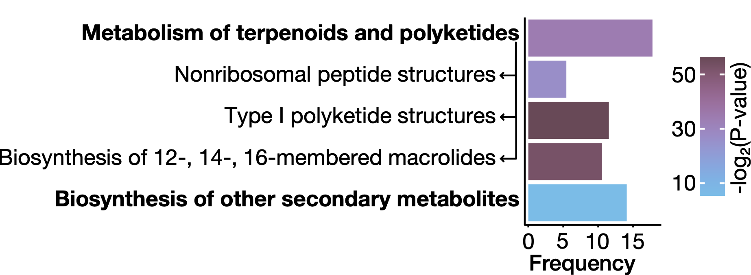
Existence of cryptic diversity has implications for ecological and biochemical studies of 'Prymnesium parvum'
Accessory Genome
variably present across strains
20,738 gene families
(44% of total)
Gene families enriched in accessory genome are involved in secondary metabolism and toxin biosynthesis
Notes:
and when you look to see what sort of gene families are enriched in the accessory genome, you see that the KEGG pathway category polyketides and terpenoids is the single most enriched category. And the specific KEGG pathways that are driving these differences are these three pathways for the production of polyketides, macrolides, and nonribosomal peptides. These pathways are involved in biosynthesis of prymnesins and other toxic metabolites, and variation in these pathways likely translate to variation in the specialized metabolic repertoire of different Prymnesin strains. So we need to be thinking about these differences when we are designing experiments to study prymnesin ecology and biochemistry.

Slide 26
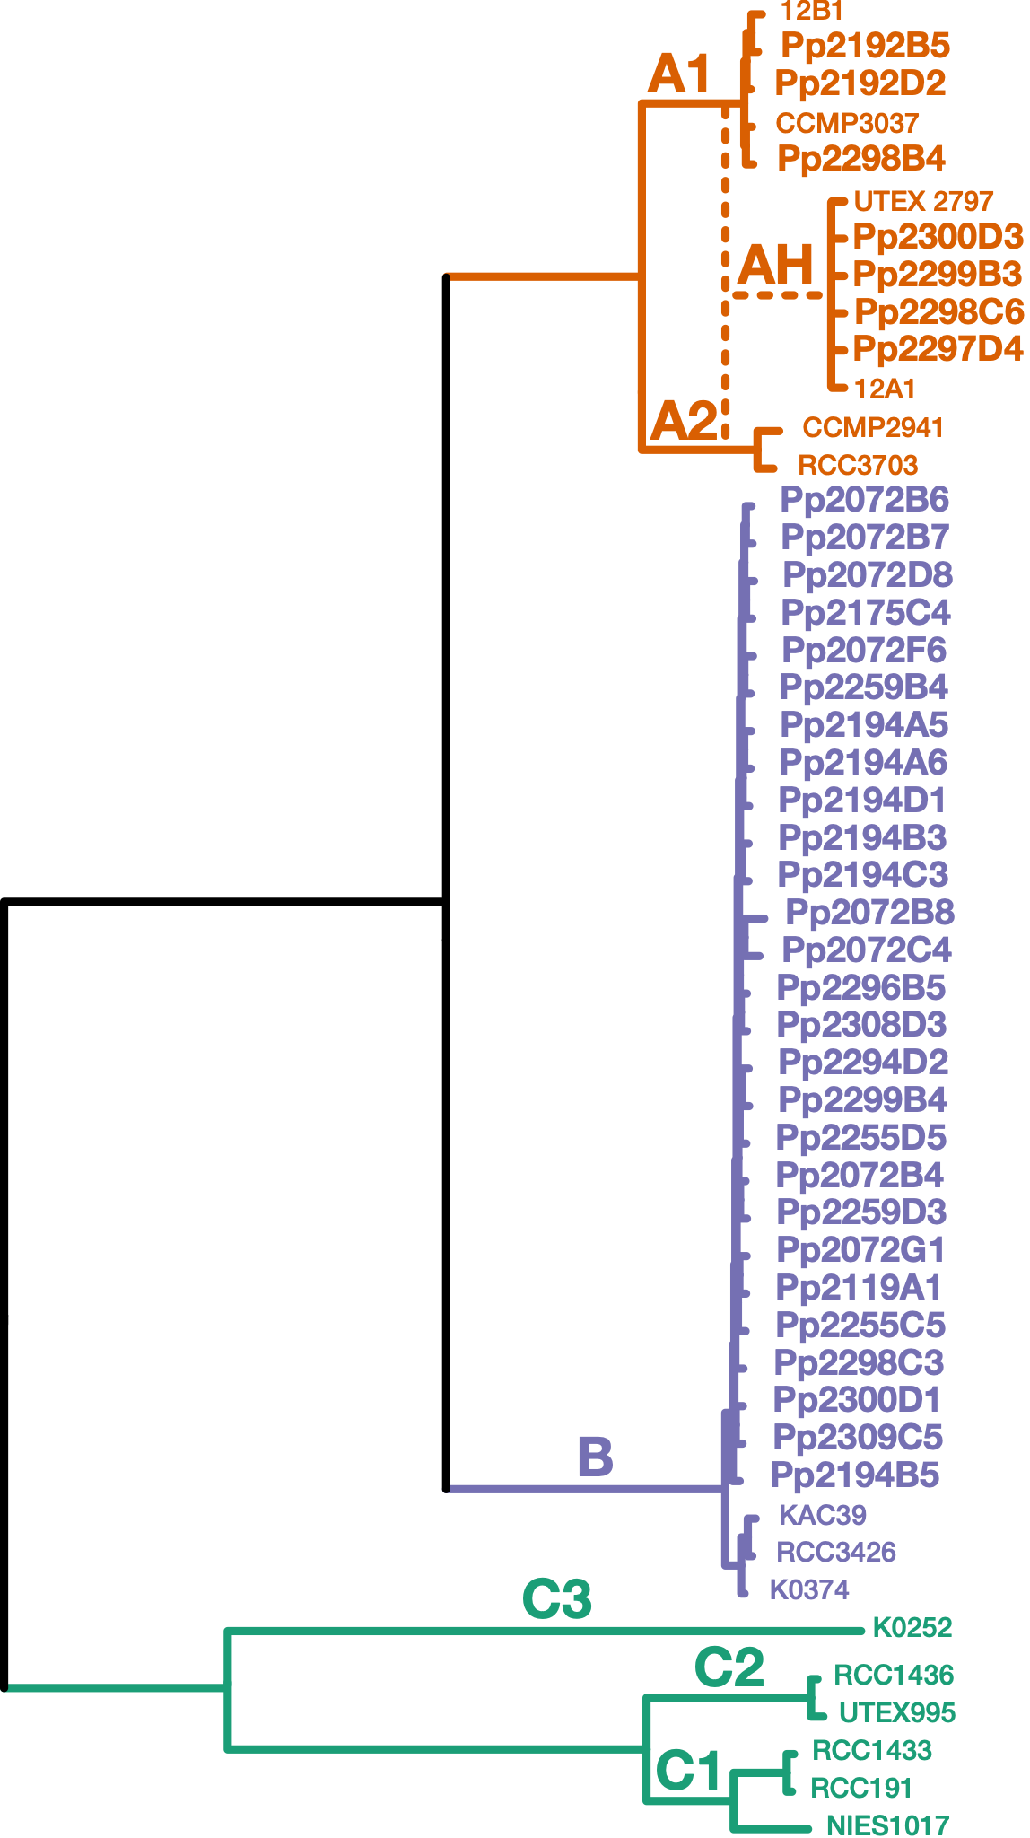
Survey of Texas blooms 2018-2020
8 of 9 blooms surveyed contained B-type P. parvum (first documentation of B-types in inland US).
Notes:
So just to recap all the genome variation present in just these 15 strains of Prymnesium parvum. We identified significant variation in haploid genome size between the different prymnesin chemotypes. We also found a lot of variation in ploidy or genome copy number between the different strains. In this talk I mostly focused on the haploids and UTEX 2797, but other strains in this analysis look to be diploid like or even triploid. And lastly, UTEX 2797 is a hybrid.

Slide 27
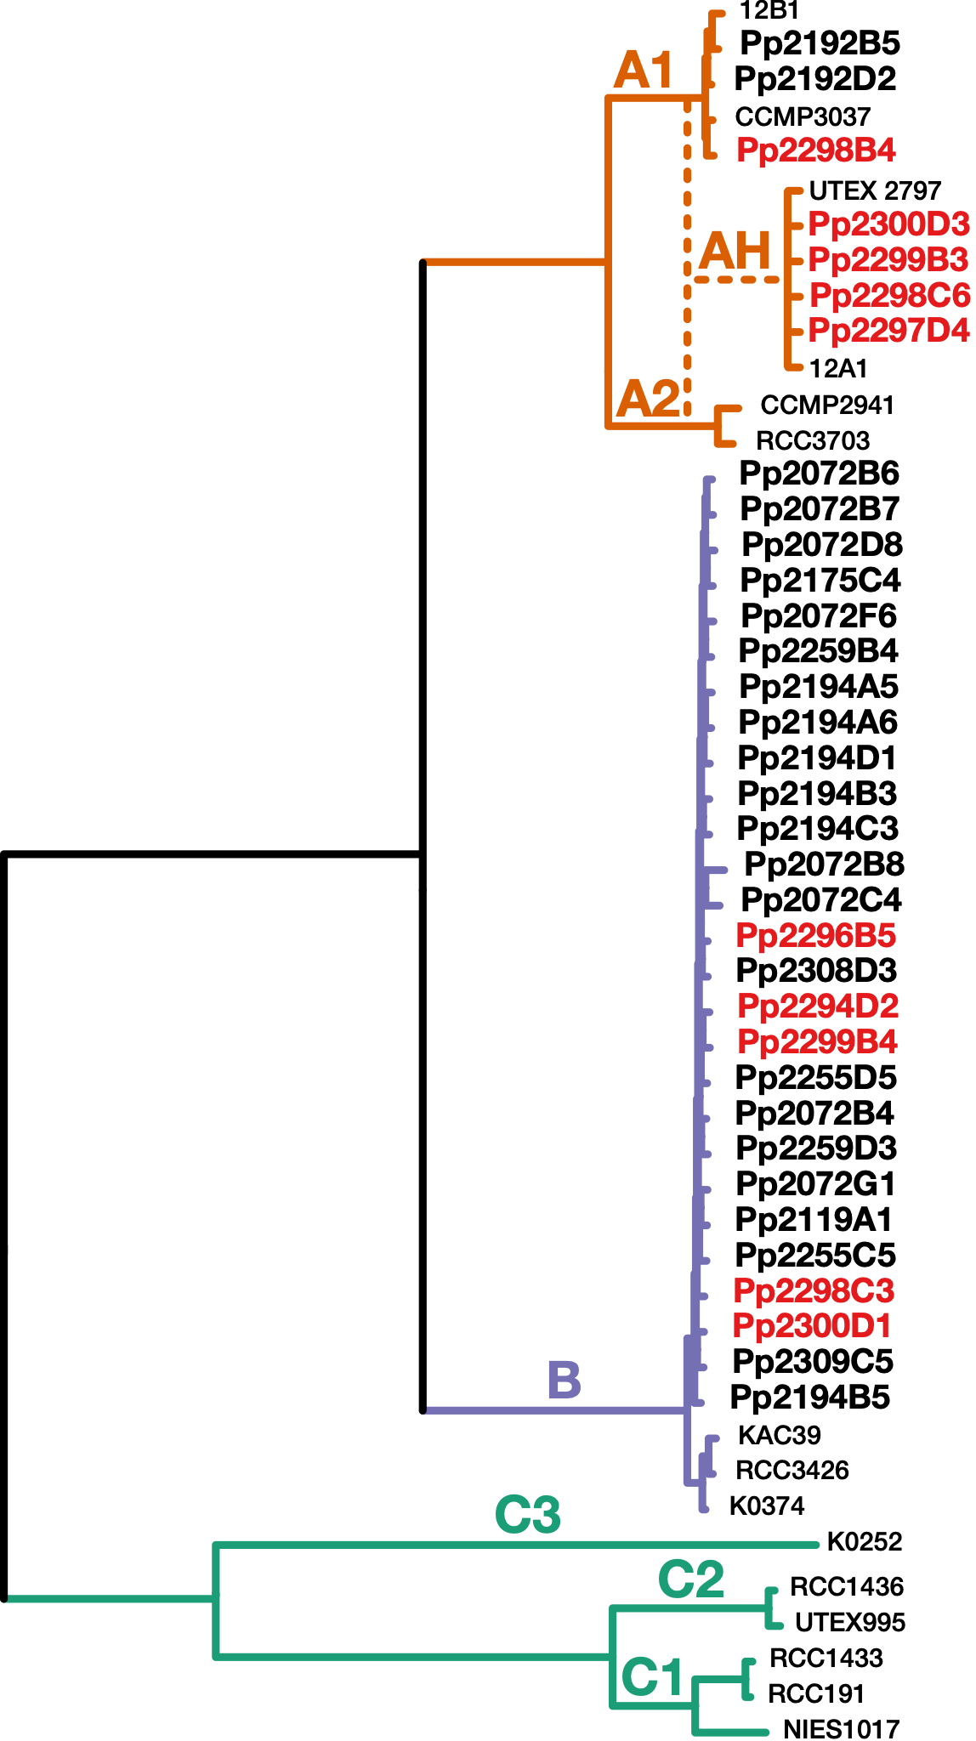
Survey of Texas blooms 2018-2020
8 of 9 blooms surveyed contained B-type P. parvum (first documentation of B-types in inland US).
2020 Possum Kingdom bloom contained A1-types, A-type hybrids, and B-types (RED).
Cryptic species of P. parvum inhabit the same bodies of water and co-occur in blooms.
Notes:
So just to recap all the genome variation present in just these 15 strains of Prymnesium parvum. We identified significant variation in haploid genome size between the different prymnesin chemotypes. We also found a lot of variation in ploidy or genome copy number between the different strains. In this talk I mostly focused on the haploids and UTEX 2797, but other strains in this analysis look to be diploid like or even triploid. And lastly, UTEX 2797 is a hybrid.

Slide 28
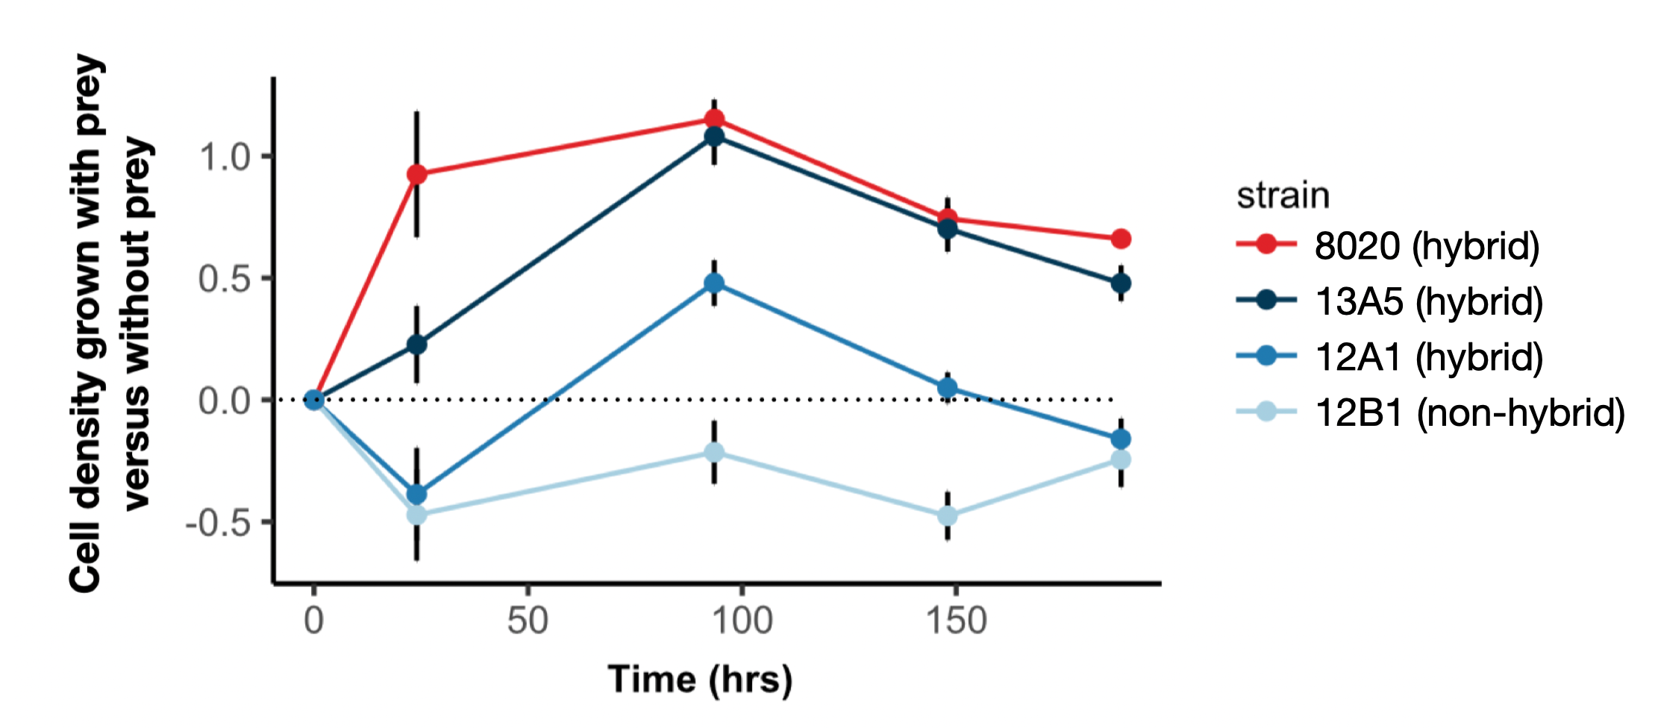
P. parvum blooms are diverse assemblages
Other species show variation in susceptibility to P. parvum attack
Genetically diverse strains of P. parvum show a continuum of growth strategy preferences
Critical need for studies investigating the relative abundances of P. parvum cryptic species and other aquatic community members before, during, and after toxic blooms. Stay tuned!
Notes:
So just to recap all the genome variation present in just these 15 strains of Prymnesium parvum. We identified significant variation in haploid genome size between the different prymnesin chemotypes. We also found a lot of variation in ploidy or genome copy number between the different strains. In this talk I mostly focused on the haploids and UTEX 2797, but other strains in this analysis look to be diploid like or even triploid. And lastly, UTEX 2797 is a hybrid.

Slide 29
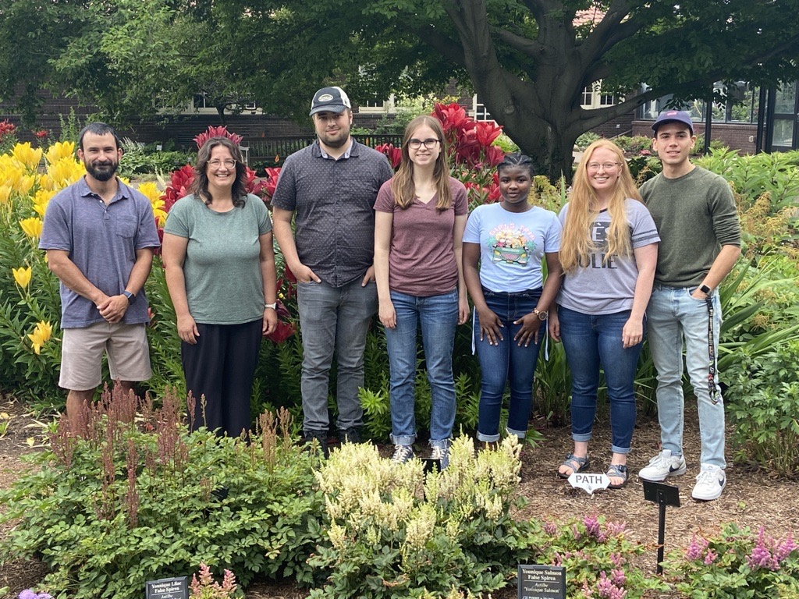
Thank you!
Collaborators
William Driscoll, Penn State
Regis Ferriere, UA
Greg Southard, TPWD
Tim Fallon, UCSD
Bradley Moore, UCSD
Schonna Manning, FIU
Dimensions of Biodiversity
Robert Auber
Amanda Pendleton
Nathan Watervoort
Olivia Riedling
Timilehin Jeje
José Colón Miranda
Read the full genome story:
Wisecaver et al. 2023 Current Biology
Notes:
Thank you!

